Slide 1


Temporal Clustering in Alzheimer’s Dataset
Mirza Shaheen Iqubal · M.Sc. Data Science, FAU
Matriculation No. 22998316

Slide 2
Agenda
Introduction
Alzheimer’s Dataset (Cross-sectional vs. Longitudinal)
Biomarkers
Preprocessing Pipeline
Temporal Clustering (KMeans)
Classification (SVM)
Results (Metrics & Visuals)
Discussion (Interpretability, Limitations, Future Work)

Slide 3
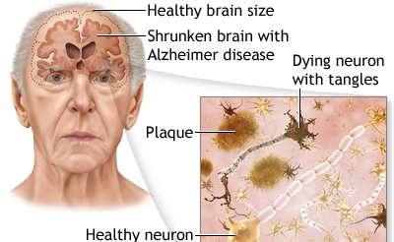
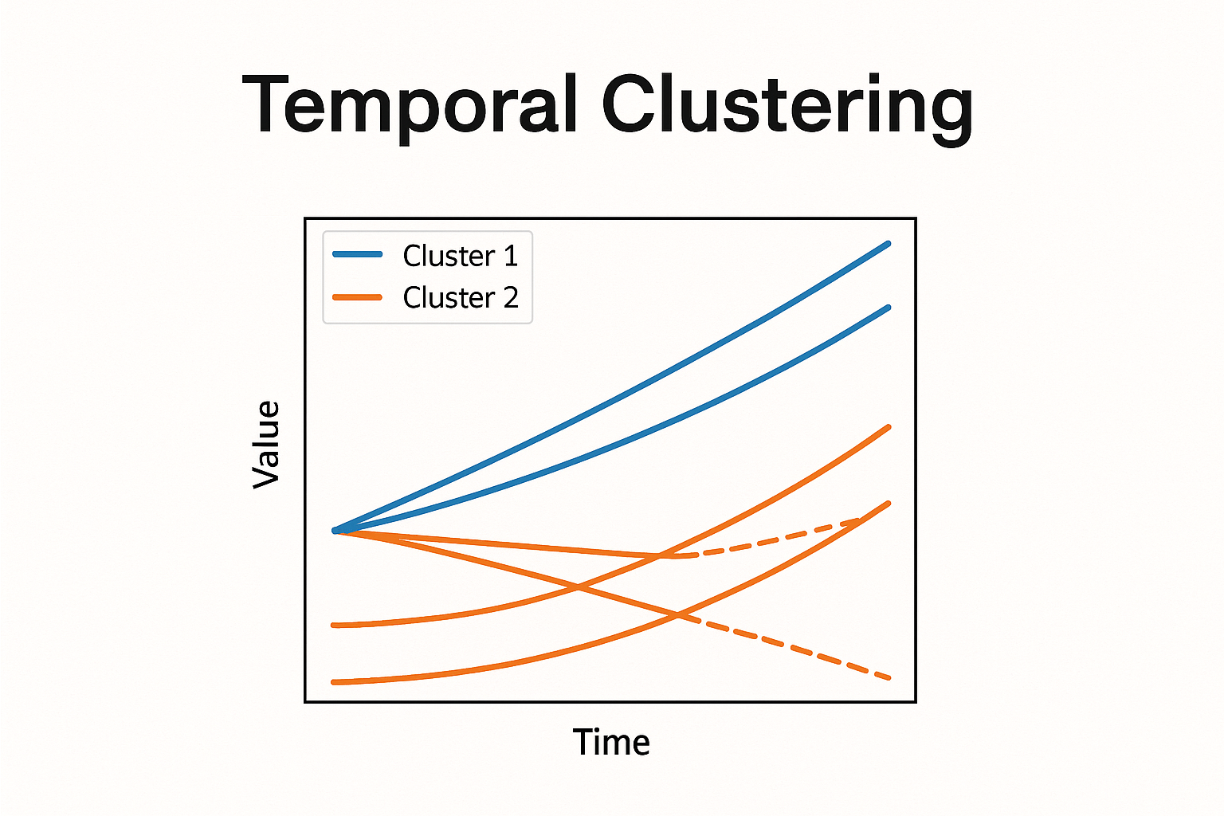
Introduction
Temporal clustering
Groups data on patterns change over time,
Considers trajectories or sequences.
What is Alzheimer’s?
Neurodegenerative disorder
Leads to progressive memory loss and cognitive decline
Most common cause of dementia worldwide

Slide 4
Introduction
Alzheimer’s → progressive neurodegenerative disease.
Most ML studies: single snapshot (cross-sectional).
Challenge: disease evolves → requires longitudinal modeling.

Slide 5
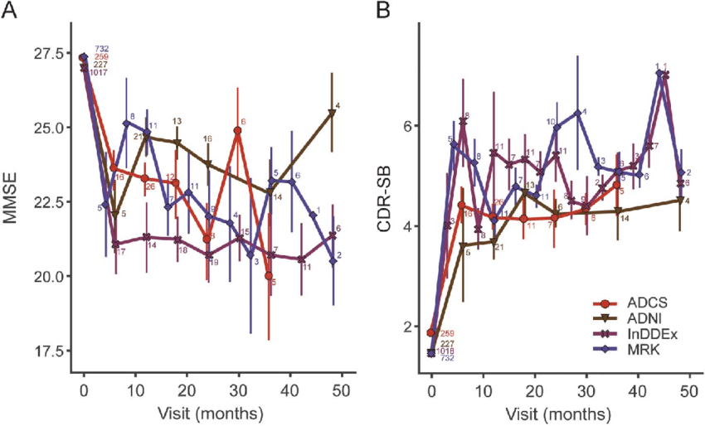
Introduction
Patient biomarkers evolve across visits
MMSE (cognitive score)
CDR (dementia rating)
Brain volume

Slide 6
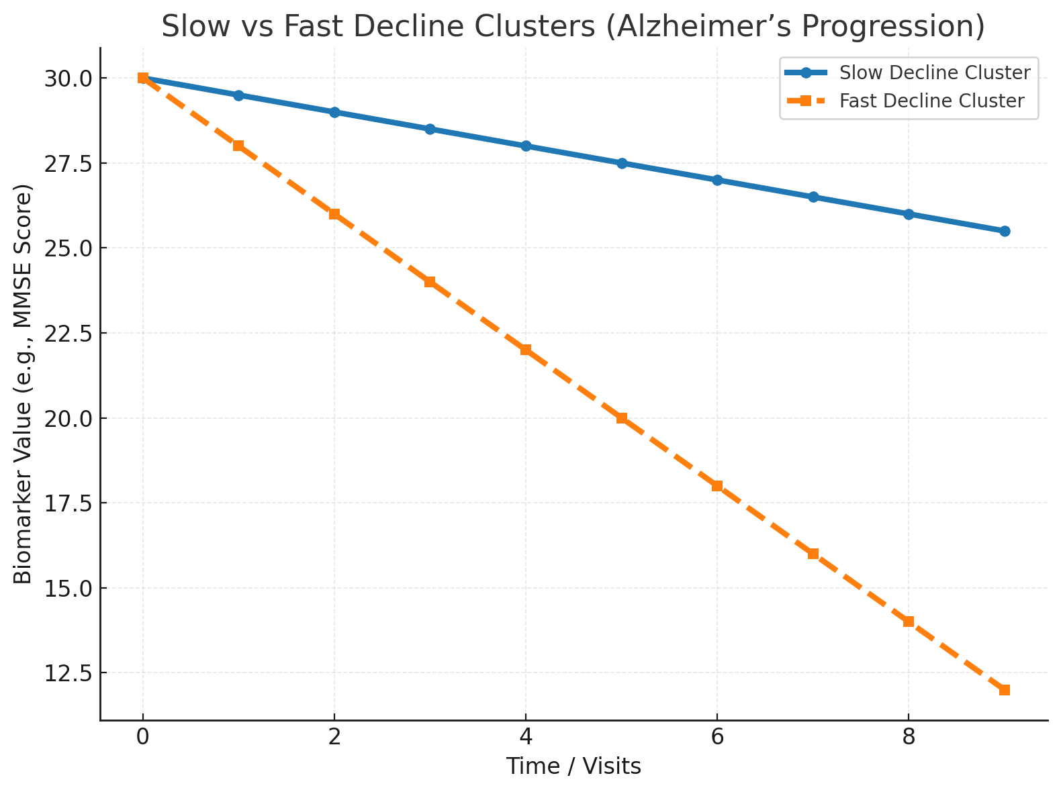
Introduction
Temporal clustering groups patients into:
Slow decline cluster
Fast decline cluster

Slide 7
Dataset
Dataset: Alzheimer’s dataset (OASIS-3, via Kaggle).
Cross-sectional: single visit per subject.
Longitudinal: repeated MRI + cognitive assessments across years.
Why longitudinal? → progression tracking.

Slide 8
Dataset Structure
1,000+ participants, ages 42–95.
Each subject: 2–15 visits.
Follow-up period: up to 10 years.
Data includes MRI scans + cognitive test scores + demographics.

Slide 9
Biomarkers
CDR: Clinical Dementia Rating (0 → normal, 0.5+ → dementia).
MMSE: cognitive ability (0–30 scale).
eTIV: estimated intracranial volume (brain size baseline).
nWBV: normalized whole brain volume.

Slide 10
Preprocessing Pipeline
Filter: subjects with ≥6 visits.
Interpolation: fill missing visits → regular timeline.
Normalization: Z-score across biomarkers.
PCA: reduce dimensionality of biomarker time series.

Slide 11
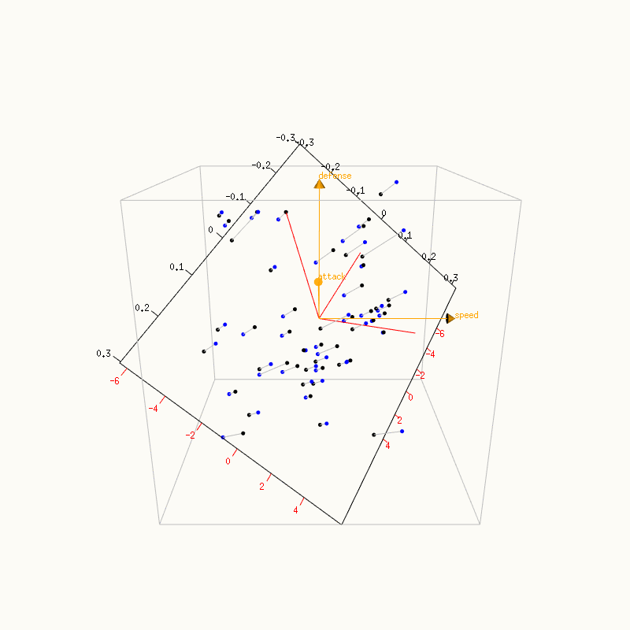
Why PCA?
Alzheimer’s biomarkers correlate.
PCA removes redundancy, reduces noise.
Trajectories become more stable + easier to cluster.

Slide 12
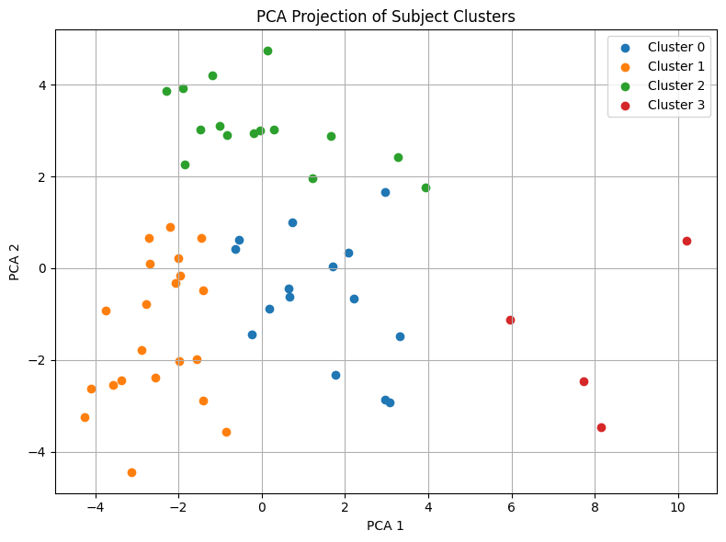
Temporal Clustering
Algorithm: KMeans on PCA-based trajectories.
Tried on k=2–4 clusters.
Evaluated using Silhouette Score.

Slide 13
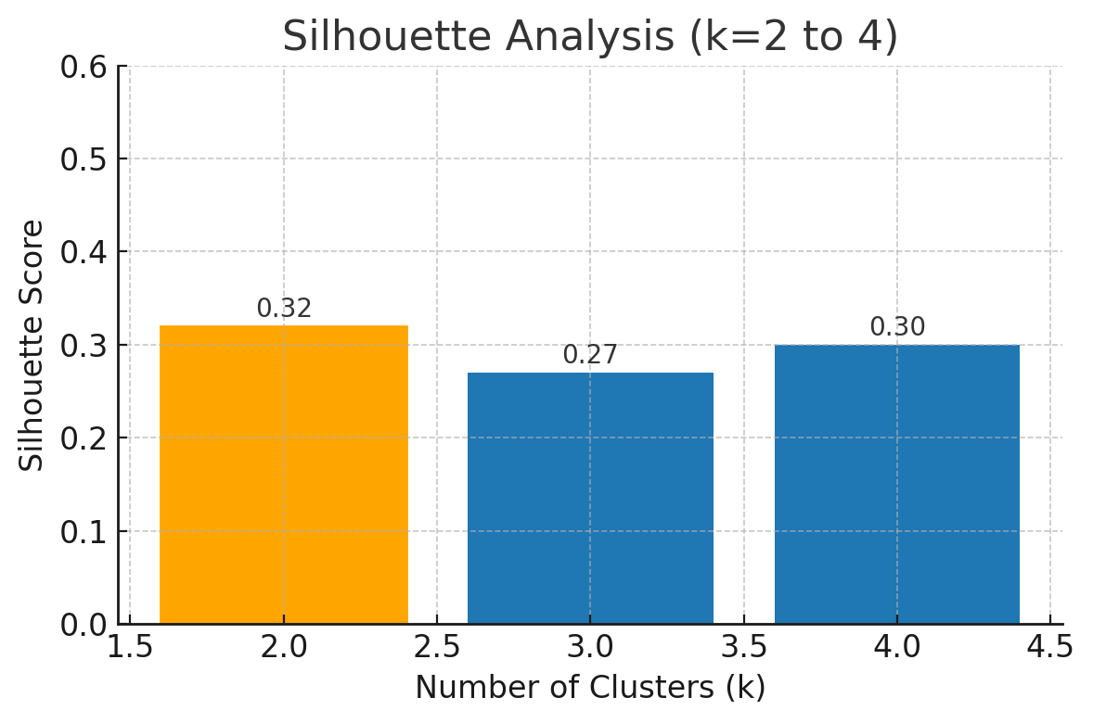
Silhouette Analysis
Obtained value: 0.32
Range: –1 → +1
~0.0 → overlapping clusters (poor separation)
0.25–0.50 → reasonable structure (moderate separation)
>0.50 → strong cluster separation
Notes:
Silhouette Score measures how well data points fit within their cluster compared to others.
We explored k=4 to inspect sub patterns, but k=2 (Silhouette 0.32) best balances separation and interpretability → Stable vs. Progressing.

Slide 14
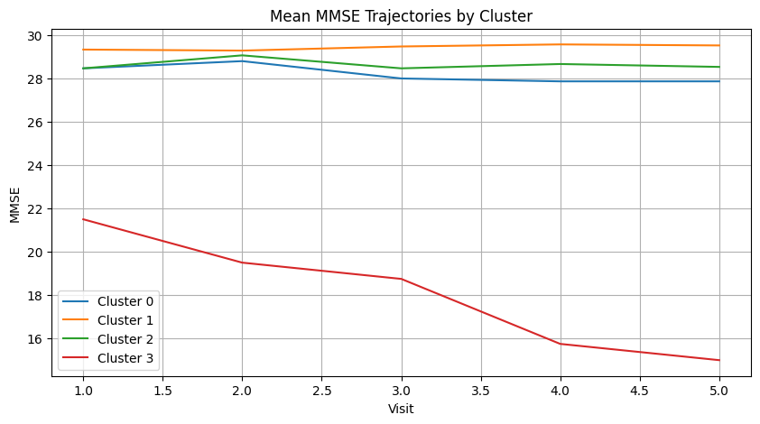
Clustered Trajectories
Clusters 0–2: High and stable MMSE (≈28–29) → cognitively normal or mild cases.
Cluster 3: Rapid MMSE decline → fast cognitive deterioration, consistent with Alzheimer’s progression.
MMSE → strong cognitive marker with clear decline in fast cluster.

Slide 15
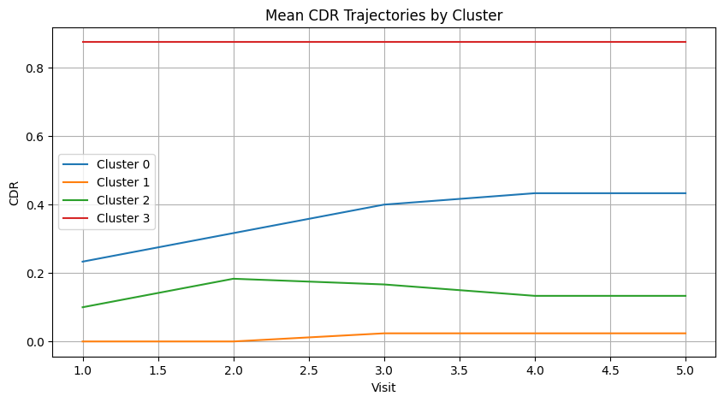
Clustered Trajectories
Cluster 3 (red): CDR ≈ 0.9 and flat → established dementia
Cluster 0 (blue): rising from ~0.25 → ~0.45 → progressing risk
Cluster 2 (green): mild and stable (~0.12–0.18) → low, steady impairment
Cluster 1 (orange): near 0 and flat → cognitively normal
good for labels and broad staging, but less useful for clustering.

Slide 16
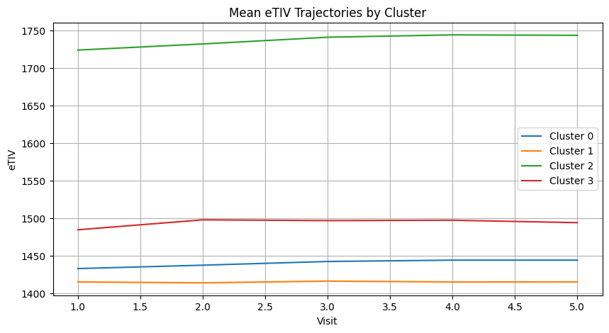
Clustered Trajectories
eTIV values remain stable across visits.
Differences between clusters are baseline only, not progression.
Confirms eTIV is more suitable for normalization than disease tracking.
eTIV → keep only as a normalization feature, not for clustering/progression

Slide 17
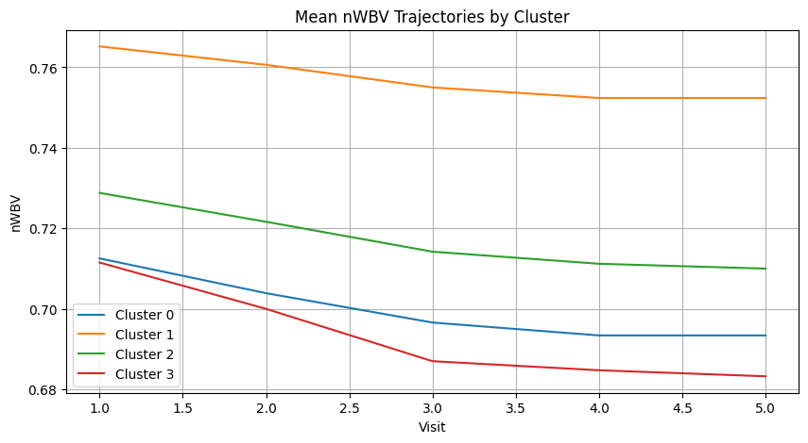
Clustered Trajectories
nWBV values show a clear decline over visits.
Decline rate differs by cluster: some remain relatively stable, others show rapid brain volume loss.
Confirms nWBV is a sensitive marker of Alzheimer’s progression.
nWBV → strongest progression marker (structural brain change).

Slide 18
Recommended markers
MMSE & nWBV → effective for temporal clustering (progression captured).
CDR → reliable for diagnosis/labels, less sensitive for clustering.
eTIV → stable baseline, useful for normalization, not progression.

Slide 19
Classification Setup
Goal: detect Alzheimer’s vs. non-Alzheimer’s.
Label: Alzheimer’s if CDR ≥0.5.
Model: Support Vector Machine (SVM).
Features: PCA components from biomarker sequences.

Slide 20
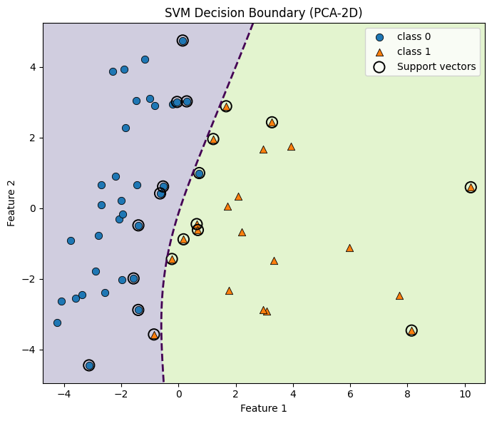
Support Vector Machine (SVM)

Slide 21
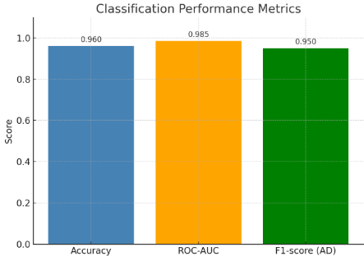
Evaluation Metrics
Accuracy: 96%
ROC-AUC: 0.985
F1-score (AD): 0.95
Strong predictive performance.

Slide 22
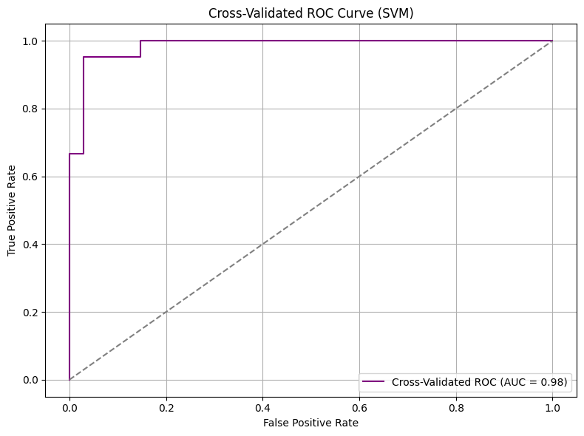
Cross Validation on ROC Curve
AUC = 0.98 → excellent classification performance.
Curve lies close to the top-left corner, showing strong separation

Slide 23
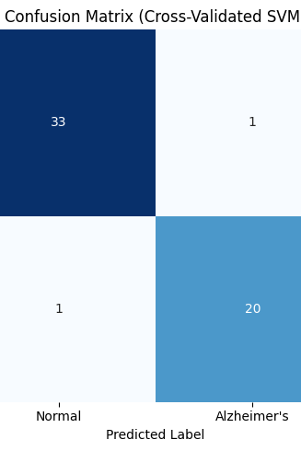
Cross-validation
5-fold validation for robustness.
Cross-validated AUC: 0.984.
Confirms generalization of model.

Slide 24
Interpretability
Two clusters = interpretable subgroups: fast vs. slow progressors.
Supports clinical decision-making.
ML outputs aligned with medical knowledge.

Slide 25
Technology Stack
Python 3.x, Jupyter Notebook
scikit-learn (PCA, KMeans, SVM)
NumPy, Pandas
Matplotlib, Seaborn
GitHub for reproducibility

Slide 26
Pipeline Flow
Preprocessing
PCA
Dataset
KMeans Clustering
Evaluation
SVM Classification

Slide 27
Limitations
Restricted biomarker set
Interpolation assumptions
Class imbalance
Model simplicity
Notes:
Restricted biomarker set: Analysis used only four key biomarkers (CDR, MMSE, eTIV, nWBV), limiting clinical depth.
Interpolation assumptions: Missing visits were interpolated, which may not fully reflect real patient trajectories.
Class imbalance: Fewer Alzheimer’s cases compared to non-Alzheimer’s may bias classification performance.
Model simplicity: KMeans does not explicitly capture temporal dependencies; PCA reduces interpretability.

Slide 28
Future Work
Extend biomarkers → PET, advanced MRI features.
Apply sequence models → HMM, LSTM, DTW clustering.
External dataset validation.
Explainability → SHAP, LIME.

Slide 29
Summery
MMSE & nWBV best markers for progression.
Clustering distinguishes slow vs. fast decline.
SVM achieves high accuracy (96%, AUC=0.985).
Approach demonstrates temporal clustering is effective for Alzheimer’s biomarker analysis.

Slide 30

References
Goutte, C., et al. (2001). Clustering fMRI time series. NeuroImage.
Chi, Y., et al. (2007). Evolutionary spectral clustering by incorporating temporal smoothness. KDD.
Marcus, D. S., et al. (2007). Open Access Series of Imaging Studies (OASIS): Cross-sectional MRI data in young, middle-aged, nondemented, and demented older adults. J. Cognitive Neuroscience.
McKhann, G. M., et al. (2011). The diagnosis of dementia due to Alzheimer’s disease: Recommendations from the NIA–Alzheimer’s Association workgroup. Alzheimer’s & Dementia.
Rousseeuw, P. J. (1987). Silhouettes: A graphical aid to the interpretation and validation of cluster analysis. J. Computational and Applied Mathematics.
GitHub Repository (Code & Documentation): 🔗 Temporal Clustering in Dynamic Medical Datasets – GitHub

Slide 31
Thank YOu
Any Questions!

